Slide 1
Treatment modalities to support soft tissue repair
LO2: Understand the use of cryotherapy during soft tissue repair

Slide 2
Assessment criteria
Explain the physiological and neurological effects of using ice during soft tissue repair
Describe methods of applying cryotherapy during soft tissue repair
Identify contra-indications to cryotherapy
Describe adverse reactions to cryotherapy
Explain actions to take in the event of an adverse reaction

Slide 3
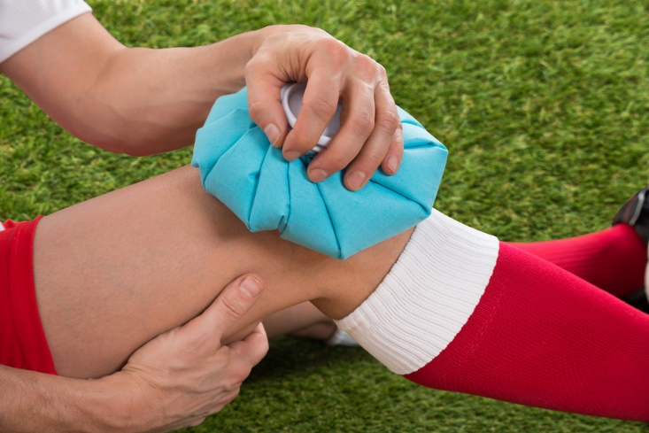

Slide 4
Healing phases or stages
What are the treatment aims for each healing stage?
The acute, or inflammatory phase
The sub-acute, or repair phase
The chronic, or remodelling phase

Slide 5
Treatment aims
Acute phase
Protect against injury
Reduce pain and swelling
Reduce bleeding
Sub-acute stage
Reduce pain and swelling
To improve mobility
To improve blood flow to damaged tissues
Facilitate optimal scar tissue formation

Slide 6
Treatment aims
Chronic phase
To restore function
To regain mobility, flexibility, and strength/proprioception
Facilitate return to sport/activity

Slide 7
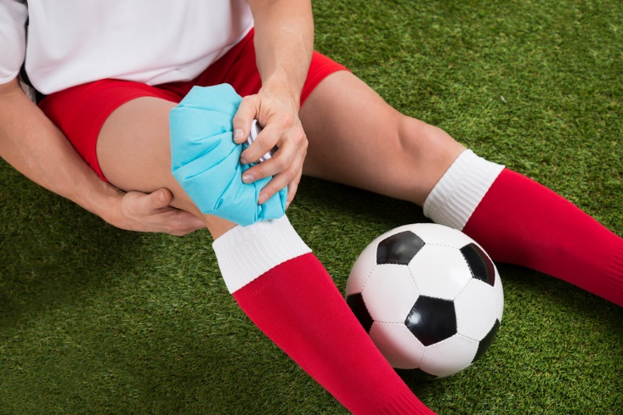

Slide 8
Physiological/neurological effects of using ice
Decreased local metabolism
Reduced oxygen requirements
Vasoconstriction
Hyperaemia
Decreased haemorrhage
Reduced muscle efficiency
Analgesia
Relaxation of muscle spasm
Reduction in nerve conduction velocity
Stiffening effect on connective tissue

Slide 9
Methods of applying cryotherapy
Ice pack
Ice cups
Cold compress
Cryocuff
Cooling creams and gels
Silica gel packs
Ice massage
Wet towel/sponge
Immersion

Slide 10
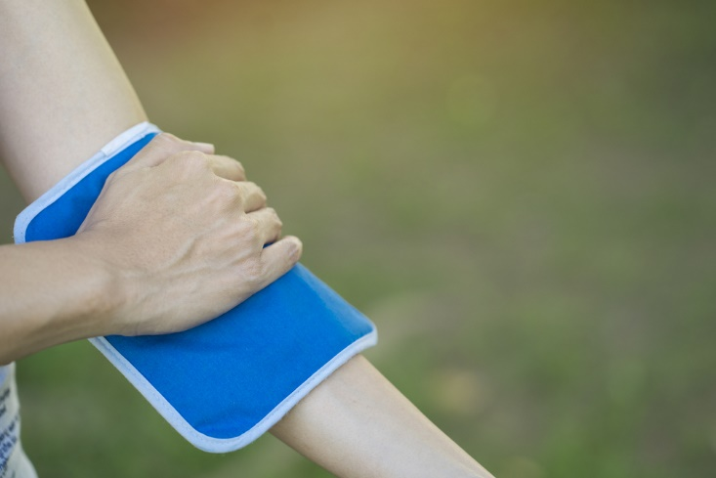

Slide 11
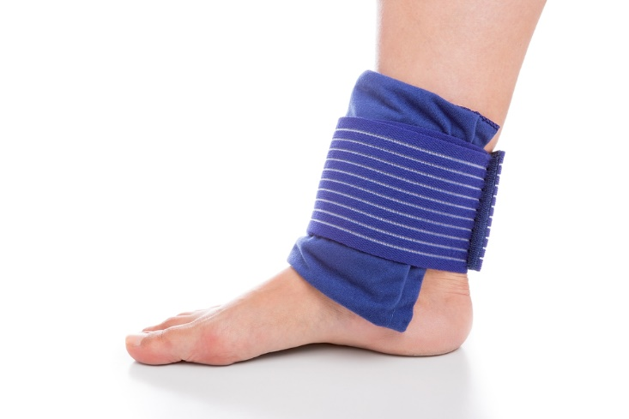

Slide 12
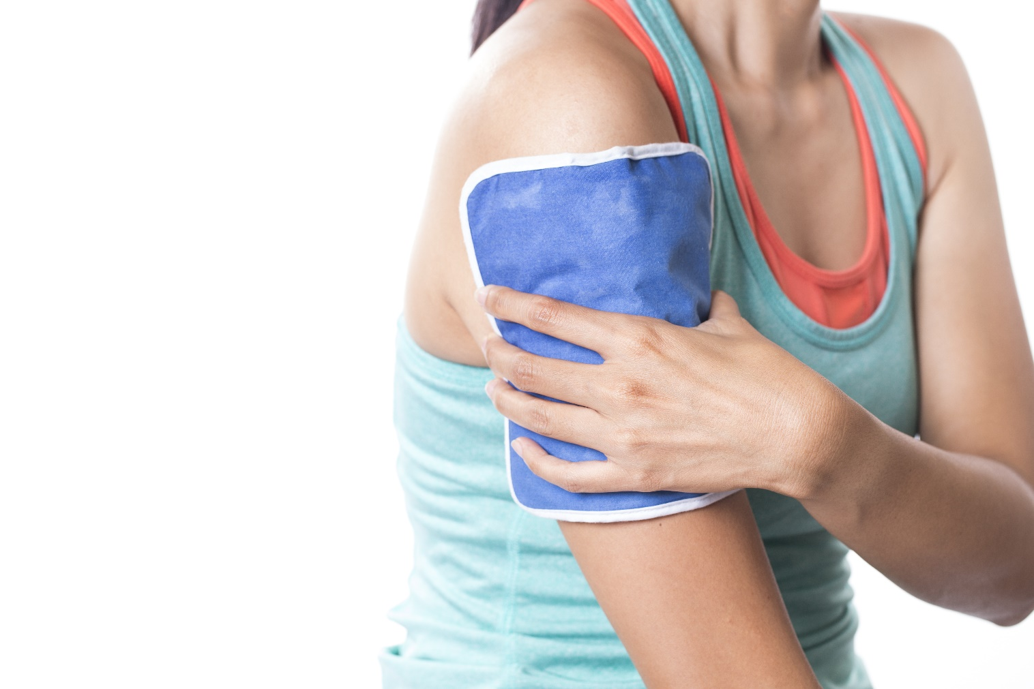

Slide 13
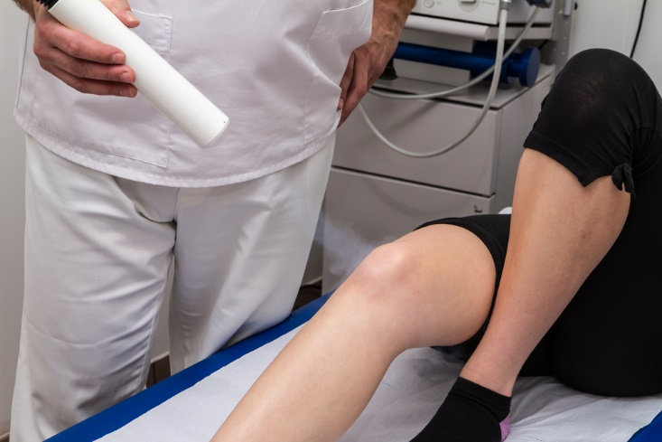

Slide 14


Slide 15
Application
Depends on location, no definitive conclusions largely due to the research evidence presented.
Every 2 hours
For 5 to 20 minutes
5-10 mins every 30min-1hour for superficial structures
Safety considerations:
Use a barrier between ice and skin, e.g. towel
    Monitor for any circulation loss
    Stick to planned duration
    Conduct a heat/cold test

Slide 16
Application and sensation
Four stages of sensations during ICE treatment:
  Appreciation of cold and coolness
  Burning
  Aching or throbbing
  Numbness
Remove ICE when numbness experienced

Slide 17
Contra-indications to cryotherapy
Vasospasm i.e. Raynaud’s disease
Acute febrile illness
Cold urticaria
Some autoimmune diseases, e.g. rheumatoid arthritis or lupus

Slide 18
Precautions
Decreased cold sensitivity and/or hypersensitivity
Circulatory or sensory impairment
Hypertension
Uncovered open wounds
Cardiac disease
Adverse psychological factors

Slide 19
Adverse reactions to cryotherapy
Ice burns or frostbite
Increased pain
Neurological effects
Hyperaemia
Allergic reaction
Chemical burns
Sudden increases in blood pressure
Uncontrolled shivering
Tiredness, fatigue
Hyper/hypoventilation

Slide 20
Actions to take in event of adverse reactions
Remove source of cold
Gradually allow to come back to normal temperature
Seek medical care if necessary

Slide 21
Learning check
LO2: Understand the use of cryotherapy during soft tissue repair
Explain the physiological and neurological effects of using ice during soft tissue repair
Describe methods of applying cryotherapy during soft tissue repair
Identify contraindications to cryotherapy
Describe adverse reactions to cryotherapy
Explain actions to take in the event of an adverse reaction

