Slide 1
Treatment modalities to support soft tissue repair
LO3: Understand the use of heat treatments during soft tissue repair

Slide 2
Assessment criteria
Explain the physiological and neurological effects of using heat during soft tissue repair
Describe methods of applying heat during the soft tissue repair process
Identify contra-indications to heat treatments
Describe adverse reactions to heat treatments
Explain actions to take in the event of an adverse reaction

Slide 3
Physiological/neurological effects of using heat
Increased local metabolism
Increase in blood flow, vasodilation, erythema
Increased oedema
Increased haemorrhaging
Analgesia
Reduced muscle spasm
Increased soft tissue extensibility
Increase in nutrient delivery to damaged tissue

Slide 4
Uses of heat therapy
Sub-acute and chronic healing stages
Pain relief - ‘pain gate theory’
Stimulate vasodilation to increase circulation
Local and general relaxation
Passive warm-up prior to use of other techniques
Method:
Duration: 5-30 minutes
Heat temperatures around 40°- 45°

Slide 5
Methods of applying heat
Infrared lamp
Wax bath
Hot compress
Hot packs
Heat pads
Silica gel packs
Hot water bottle
Immersion
Hydrotherapy

Slide 6
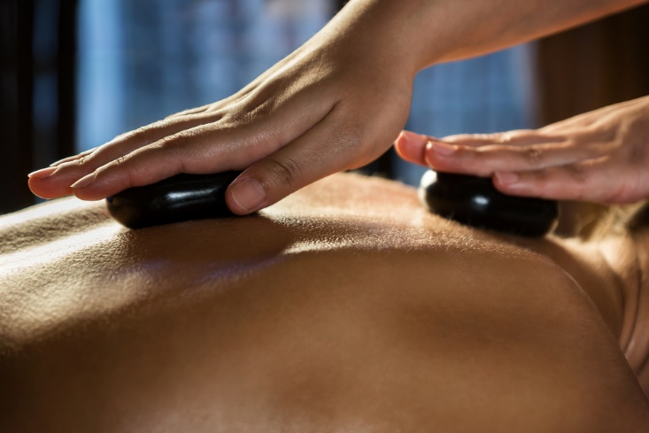

Slide 7


Slide 8
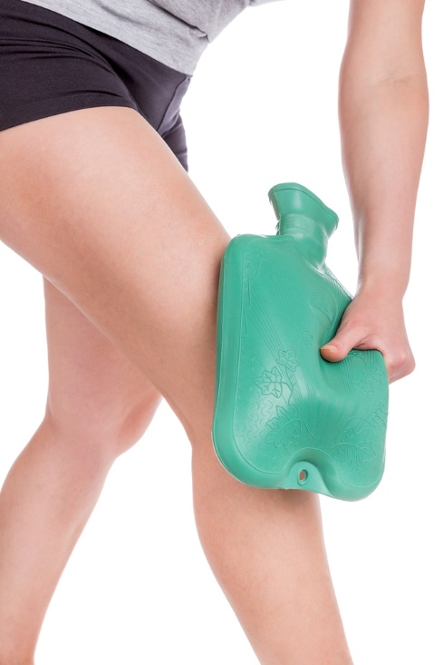

Slide 9
Contra-indications to heat treatments
Acute phase of injury (inflammation present)
Decreased sensitivity to heat
Recent haemorrhage of the treatment area
Skin carcinoma or skin condition that can be worsened by heat
Deep vein thrombosis (DVT)
Acute dermatitis
Dysfunctional circulatory system
Precautions:
Impaired local circulation
Damaged or infected tissue

Slide 10
Adverse reactions to heat treatments
Burns
Scalds
Chemical burn
Increased blood pressure
Decreased blood pressure
Muscle metabolic fatigue
Optical damage
Dizziness
Nausea
Headaches
Increased oedema
Heat stroke
Discomfort/pain

Slide 11
Actions to take in event of adverse
reactions:
Remove heat source
Cool skin rapidly under running water
First aid if required
Seek medical attention if necessary

Slide 12
Learning check
LO3: Understand the use of heat treatments during soft tissue repair
Explain the physiological and neurological effects of using heat during soft tissue repair
Describe methods of applying heat during the soft tissue repair process
Identify contra-indications to heat treatments
Describe adverse reactions to heat treatments
Explain actions to take in the event of an adverse reaction

